Slide 1
Title: Cloud Deployment, Monitoring & Business Continuity Blueprint
Subtitle: Assignment 5 – IT Infrastructure & Resilience Design
Presented By: Laiba
Program: LIFT CLUB PK - Information Technology Internship

Slide 2
Objective & Platform Choice
Objective: To design a secure, scalable, and resilient cloud architecture for a hypothetical digital application, ensuring high availability and disaster recovery.
Platform Chosen: Amazon Web Services (AWS)
Why AWS? Industry-standard reliability, robust security features (WAF, IAM), and transparent, cost-effective pricing for small-scale deployments.

Slide 3
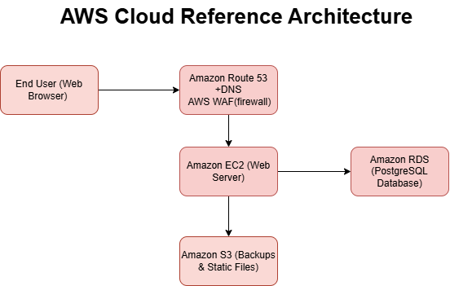
Cloud Reference Architecture
Entry & Security: Route 53 (DNS) + AWS WAF (Blocks DDoS/Malicious traffic).
Compute: Amazon EC2 (Hosts the application backend).
Database: Amazon RDS - PostgreSQL (Managed, automated backups).
Storage: Amazon S3 (Static files & secure database snapshots).

Slide 4
Security & Identity Management
IAM & RBAC: Strict Role-Based Access Control. Admins get full access; developers get limited deployment access.
Principle of Least Privilege: Users are granted only the minimum permissions necessary.
Secret Management: Database passwords and API keys are never hardcoded. They are securely managed via AWS Secrets Manager.

Slide 5
Business Continuity & Recovery SOP
Disaster Recovery Plan:
Isolate the failed/compromised EC2 instance.
Provision a new EC2 instance from the latest AMI.
Restore RDS database from the last automated daily snapshot.
Redirect traffic via Route 53 DNS.
Verify system integrity and document the incident.
Targets: Recovery Time Objective (RTO) < 2 Hours | Recovery Point Objective (RPO) < 24 Hours.

Slide 6
Proactive Monitoring & Estimated Cost
Monitoring: Amazon CloudWatch tracks CPU (>80%), DB connections, and disk space.
Alerts: Amazon SNS sends instant Email/SMS alerts to IT Admins on threshold breaches.
Automated Response: Auto-Scaling Group replaces unhealthy instances automatically.
Estimated Monthly Cost: ~$33.65 USD (EC2, RDS, S3, Data Transfer).

Slide 7
Conclusion
Successfully designed a production-ready, secure, and cost-effective cloud blueprint.
Ensures 24/7 monitoring, strict security compliance, and rapid disaster recovery.
Fully meets the business continuity and operational resilience requirements of LIFT CLUB PK.
Thank You! Any Questions?

